Slide 1
Streaming Analytics on Microsoft Azure Presenter Name Role
Real Time Analytics
Notes:
Keep the Sensor Tag Power BI dashboard up
What do you think this dashboard represents? Believe it or not, right now in this room, the temperature is xx degrees and the relative humidity is yy. And, I know it because I have a sensor here that is measuring the live temperature and live humidity in this room right now and that’s what you are seeing here. Why is this interesting and Why am I starting with this? It is because by the end of this session, if you are not able to do this and a whole lot more by yourself then I have failed. Let’s actually go ahead and talk about what this session is all about. All that is possible with the help of Azure Stream Analytics.
My name is xx and today I am here to talk to you about Streaming analytics on Azure.

Slide 2

Time to action determines how quickly data needs to be analyzed
Detect transaction fraud
90ms
Upsell and Cross-sell on the web
120ms
Detect & stop an overheated engine
3 sec
React to competitor price changes
2 minutes
Notes:
So, what is meant by streaming analytics ? Streaming analytics refer to analyzing fast moving data streams and events, while the data is still on the wire. In traditional data analytics you first store the data in a database, a data warehouse or a data mart, and then run analytics on the data to uncover insights you need to innovate. But, not always you have the luxury of time to do that – as there are insights that have a lot shorter shelf life for you to act on them.
For example, you have just a few milliseconds to detect a transaction fraud and stop it, you have less than a second to analyze a customer shopping patterns on a ecommerce site and recommend upsell and cross sell options, you have 3 seconds to stop an overheated engine and so on. If you take more than 1 second to detect a fraudulent transaction or a minute to detect an overheated piece of machinery – the damage in all likelihood is already done. This is why Stream analytics is gaining a whole lot of momentum. More and more organizations are starting to use stream analytics, and the space is expected to grow at more than 40% CAGR according to Forrester – One of the fastest growing big data segments.
To wrap up, think about it like you bring data to the query, rather than the usual paradigm of you bringing the query to the data.

Slide 3




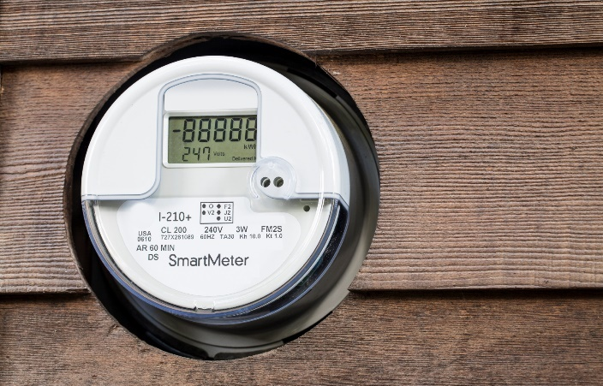



Opportunities for real time analytics are plenty
Real-time fraud detection
Fleet management and Connected cars
Clickstream analysis
Real-time patient monitoring
Smart grid
Customer behavior in stores
IT Infrastructure and Network monitoring
Real time demand and inventory management
Notes:
You will have customers in a variety of industries who need real time analytics. In financial services for Fraud detection, for real time updates on liquidity and asset positions.
Transportation and Logistics. This area is booming. You all have heard about connected cars. What is at the heart of connected cars? It is all about sensor data and making real time decisions based on situational awareness and ambient conditions.
In retail, Clickstream analysis for online shopping experience and providing cross-sell and upsell recommendation in real time ; and in a traditional store understanding user behavior and taking necessary actions.
Monitoring patients and security of electronic health records in real time in healthcare.
Managing smart grids, real time building energy consumption etc – All of these need real time analytics.
To deal with all these sensor and streaming data, you will need an ingestion system and more importantly you will need a real time analytics processing system. How can I get alerts, get notified or trigger a business process when I cross a threshold or anomaly is detected, how can I process this data – all in real time. Microsoft is best cloud solution as well as we have the best tools to cover the gamut of all these problems.
Now, for the rest of the session, I will tell you what is ASA and what is the value it provides to our customers over other solutiosn

Slide 4
On Azure
Azure Stream Analytics
Apache Storm on HDInsights
Spark Streaming on HDInsights
Microsoft offers multiple stream analytics solutions
On Premises
StreamInsight
Notes:
Good news is Microsoft offers multiple streaming analytics solutions on Azure and On Premises.
We’ve offered StreamInsights with SQL Server starting in 2008 onwards, and we kept innovating on this based on customer and user feedback. We took all the rich learnings from this and built Azure stream analytics on the core foundation that Streaminsights was based on. So, even though Azure Stream analytics has been around for around 2 years, we have more than a decade worth of learnings baked into it.
On Azure, we offer multiple fully managed options. First and foremost, we have Azure Stream Analytics – our own proprietary cloud solution. But, we also offer open source frameworks such as Apache Storm and Spark streaming.

Slide 5



What is Azure Stream Analytics
Fully Managed
Enterprise Grade
Developer friendly
Notes:
First, let us look at Azure Stream Analytics.
Azure Stream Analytics is a Microsoft proprietary fully managed, enterprise grade, developer friendly cloud service for real time analytics on streams of data, that uses very developer friendly simple SQL like query language.
Show of hands:
Everybody who knows SQL here raise their hands
Everybody know Java and can write temporal logic to do analytic processing on a time series data raise your hands, or .NET or any of those. This is precisely why we used SQL
Before, we dive deeper on Azure stream analytics specifics, let us look at a few customer examples from across multiple industries.

Slide 6
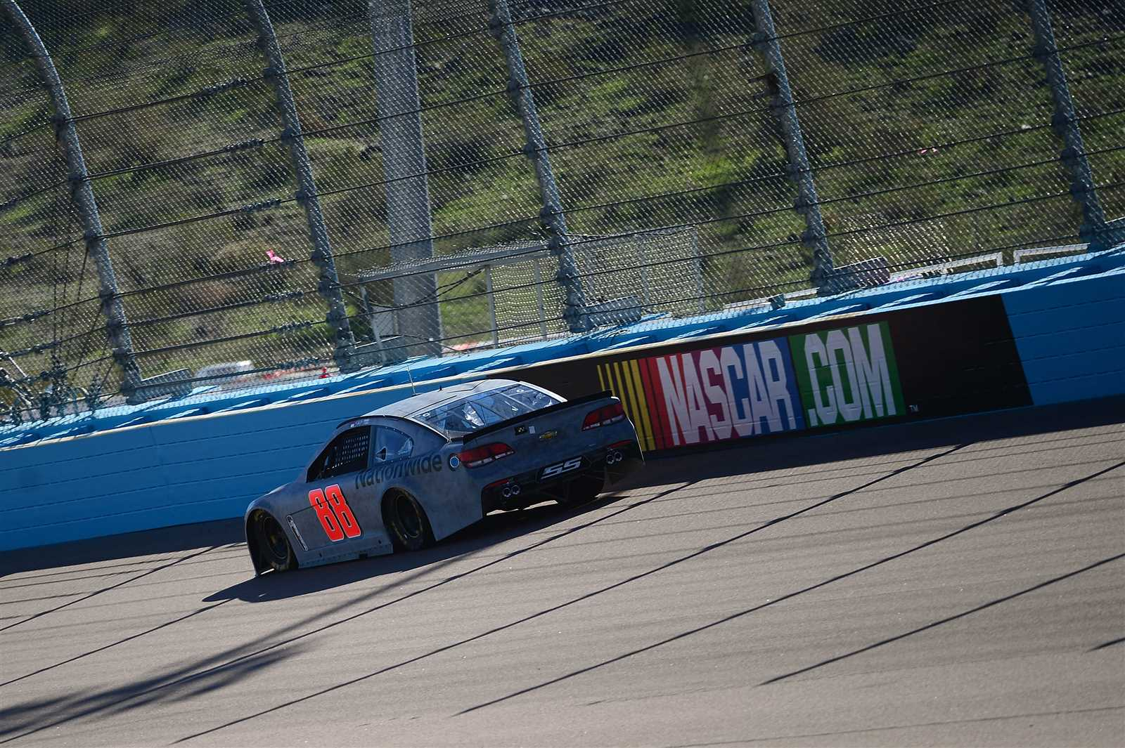

Real-time race telemetry
“We use real-time geospatial analytics with Azure Stream Analytics for analyzing race telemetry during and after the race”
- Betsy Grider, Managing Director of Technology Development
Notes:
Speed is at the heart of everything that NASCAR does. NASCAR and Microsoft worked closely together to build a set of solutions to help address their needs around race day telemetry. NASCAR currently uses Azure Stream Analytics for critical scenarios such as tracking each vehicle continuously on the track, and more accurately determine the relative positioning during race restarts. Also, they use Stream Analytics to identify pit-lane speeding during or after the races.

Slide 7


Making buildings smarter
“The queries we need to run are quite complicated.... We are able to do this much quicker with Azure Stream Analytics, and with very low overhead.”
- Arvind Shetty, Technology Specialist
Benefits ▪ Greener Buildings ▪ Comfortable occupants
Notes:
Honeywell Building Solutions is a global business leader in energy efficiency and building automation. They install and manage integrated building control systems for air-handling, lighting, life safety, and security systems for thousands of commercial, residential, municipal, and industrial facilities around the world. Customers look to Honeywell to help them conserve energy and perform prompt and meticulous maintenance on the equipment that keeps their buildings safe and comfortable. To do this, Honeywell Building Solutions tracks the condition and performance of these assets with on-site sensors that capture and record up-to-the-minute information. Each remote sensor collects 20 to 40 distinct data points related to room temperature and humidity from each of the various units across a building.
Honeywell needed a system that could transform the collected data into useful, timely information its customers could act on. For example, if Honeywell could predict when a filter on an air-handling unit needed to be replaced, instead of replacing it on a fixed schedule regardless of need, it could save the customer not only the cost of the filter but also the shipping and installation costs. Honeywell knew this kind of preventative maintenance could also potentially extend the life of that unit by 10 or even 15 months. Multiplying these savings over the thousands of assets it services across hundreds of buildings would mean Honeywell could offer its customers significant savings.
https://azure.microsoft.com/en-us/blog/azure-stream-analytics-innovative-use-cases-by-customers/

Slide 8


Opening new opportunities in healthcare
“The ability to collect vital telemetry data from deployed devices has been a key objective of ours. A cloud-based solution allowing us to collect data on device performance in real-time helps us to be more proactive in our customer support and ensure that our NIOX devices help the physicians deliver the best possible outcome for the patient,”
- Scott Myers, CEO
After the transaction
Benefits ▪ Improved patient care ▪ Newer revenue models
Notes:
Aerocrine is a medical devices company based in Sweden. One of the first customers who adopted Azure stream analytics. They sell this device right here. This device here helps connect asthma patients with remote doctors. Why is this interesting? With Aasthama, doctors need to know not just your lung capacity, but at any given point of time how much air you can keep in your lungs at any time. Blowing out and blowing into this. To understand your lung capacity, when you go to a doctor, the doctor asks you to blow into a device with a floating ball and has you try and keep the ball between a couple of markers. Now, I can stay in any location I want, and with this device my doctor can monitor in real time and get alerted – if say, I am at risk of an asthma attack and take proactive action. In addition, the device also measure several ambient comditions around the patient such as temperature, humidity etc – that could trigger asthama attacks or intervene with the device calibration, and provides proactive alerts to the patient.
Not only this, Aerocrine wanted to sell a service – not just a device – so that they can monetize the physician services.
Read Press Release
Read the Case Study

Slide 9


Helping retailers increase sales through real time analytics
“As NEC continues to expand its strong solution portfolio to customers globally.. the power of NEC's biometrics technologies combined with Azure based cloud-based services can be delivered to our customers across geographic boundaries”
- Naohiko Torii, Senior Manager
Benefits ▪ Run successful promotions in real time ▪ Better customer service
Notes:
NEC want to reinvent the retail business. They have interesting facial recognition and video IP – based on that they can tell if it is a male / female, what is their age and were able to provide their customers, retail store managers – a perfect snapshot of what exactly is happening in the store at that very moment such as real-time demographics of the people who are there in the store, a real time dashboard and recommendations on what promotion you need to do based on age, gender and where people are in the store etc.
http://www.nec.com/en/press/201504/global_20150409_02.html

Slide 10


Innovative farming helps improve patient lives
“By leveraging the Microsoft Azure IoT and the Fujitsu platform, we are able to deliver real-time visualization of big data analytics to improve the entire production”
- Hiroyuki Sakai, Vice President
Benefits ▪ More healthy choices for patients ▪ Newer revenue opportunties
Notes:
Fujitsu wanted to get into Agriculture IoT. They hired several data scientists who were specialized on this aspect, to augment the conditions in which crops are grown. In this case, how they wanted control the content of Potassium in lettuce to make it easier for people with certain kidney conditions to consume it. People with certain conditions can’t tolerate even moderate levels of Potassium. Fujitsu had a good sense of what were the ideal conditions -temperature, humidity etc that were necessary to control the amount of potassium in the lettuce. The telemetry from the lettuce farm continuously monitored these streams of data and sent out alerts wherever these readings fell out of tolerable ranges. More importantly, they could automate actions based on this data by sending a command signal to the actuators. For example, if the soil was getting dry, they were able to water that particular section with an actuator in that particular area. No more need to send an individual to water that section.
http://news.microsoft.com/2015/04/12/fujitsu-and-microsoft-collaborate-to-transform-manufacturing-processes-through-iot-innovation/#sm.00007mwy0w19b2dh5toew49eud2bm

Slide 11



Real time analytics enable better business outcomes
“Plant equipment heat and vibration readings are passed along to asset management teams to ensure our equipment is being maintained correctly. Production output can be tracked and provided to our regulator to ensure compliance, and our commercial teams use this telemetry for billing purposes”
- Kent Weare, Lead Architect
Benefits ▪ Lower equipment failures and downtime ▪ Secure infrastructure ▪ Lower operational costs
Notes:
https://customers.microsoft.com/en-US/story/canadian-power-generator-shines-light-on-numbers

Slide 12


Azure Stream Analytics Usage Pattern
Event production
Collection
Stream
Ingestion
Stream Analytics
Storage and
Batch Analysis
Presentation and action
Event Hubs
Event Hubs
Applications
Service Bus Queues, Topics
Web clients
Devices
Stream Analytics
IOT hubs
SQL DB
Legacy IOT (custom protocols)
Search and query
Storage Blobs and Tables
Cloud gateways (web APIs)
Blobs
Document DB
IP-capable devices (Windows/Linux)
Power BI
Machine
Learning
Azure Data Lake
Low-power devices (RTOS)
Field gateways
Reference
Data
Power BI
more to come…
Devices to take action
Notes:
Azure Stream Analytics helps sell larger solutions and drags many workloads and services with it.
You have devices and applications that generate data on the left that can connect directly or through cloud gateways to your stream ingest sources. Azure Stream Analytics can pick up the data from these ingest sources, augment it with reference data and run necessary analytics, gather insights and push them downstream for action. You can trigger business processes, write the data to a database, or simply view the anomalies on a dashboard.
Let me talk about Stream ingest technologies while we are here.
Event Hub: Think about it like a Global scale event ingestion system where I can publish events from millions of sensors and applications. This will guarantee you that - as soon as an event comes in here - a subscriber can pick that event up within a few milliseconds. I can have multiple subscribers too.
IoT Hub: IoT hub is very similar to Event hub but takes the concept a lot forward. And the reason for this is the bidirectional actions you can take. It will not only ingest data from sensors in real time but can also send commands back to those . It enables you to do things like device management. Enable fundamental aspects such as Security – a fundamental need for IoT is built into it. So, whenever customer is thinking about IoT, think of ingesting data into the IoT hub. On the contrary when customer is thinking about scenarios like real time financial fraud detection, social media sentiment analytics etc – think about event hub.

Slide 13
Microsoft Azure IoT Suite
Web/Mobile App
Power BI
Devices
Back end systems and processes
Storage blobs
DocumentDB
IoT Hub
Stream Analytics
Event Hub
Web Jobs
Logic Apps
Azure
Active Directory
Notes:
Azure Stream Analytics is central to multiple strategic bets of Microsoft.
First is the IoT suite. For example, you’re not going to go to Boeing or Schneider electrics of the world to sell them just Stream analytics – you will sell them Azure IoT suite but you will need to know Azure Stream Analytics- which is a core part of IoT suite. For remote monitoring of devices or command and control operations – you need Azure stream analytics. So, pay attention because customers are going to ask you questions about it very soon.

Slide 14



Microsoft Cortana Intelligence Suite
Information Management
Big Data Stores
Machine Learning and Analytics
Intelligence
Data Sources
People
Data Factory
Data Lake Store
Machine Learning
Cognitive Services
Data Catalog
SQL Data
Warehouse
Data Lake Analytics
Bot Framework
Web
Apps
HDInsight
(Hadoop and Spark)
Event Hubs
Cortana
Mobile
Apps
Stream Analytics
Bots
Dashboards & Visualizations
Sensors and devices
Power BI
Automated Systems
Data
Intelligence
Action
Notes:
Azure Stream Analytics is also a part of the Cortana Intelligence Suite. Why is there need for a streaming solution within Cortana intelligence suite? Take for example, a very large travel company, probably one of the largest in the world is using Azure Stream Analytics to detect when their servers are down so that they can immediately go and patch or replace those servers to help their site performance AND uptime. Data is coming from SCOM events and other solutions to this real time processing solution. Stream Analytics detects anomalies and triggers system processes to create serviceNow tickets OR show them in live dashboards in Real time to monitor the status of the system. In order to do this – you need everything in Cortana Intelligence suite (Dashboards, data movement, etc) to work in concert with Azure Stream Analytics.
Let’s say you want to go and help a big company like Toyota with connected cars scenario and give intelligent recommendations with predictive maintenance and – you need to lead with IoT suite and Cortana Intelligence suite. Stream analytics helps bring both these together.

Slide 15
Demo
Notes:
SHOW ASA PORTAL DEMO 2xJOBS WITH SENSOR TAG DEMO
Create EH input config
Show query
Show O/P
Avg temp..
Anamoly, any sensor >85.
Sensor tag alerts demo,
Query.

Slide 16

Fully Managed
Zero upfront costs
Up and running in seconds
No SW or HW maintenance
No performance tuning
Pay only for usage
Notes:
Azure Stream Analytics is a fully managed PaaS service on Azure.
First, there are no upfront costs or costs involved in setting up compute clusters and complex hardware wiring like you would do with an on-prem solution.
You only pay for what you use. If you have scenarios where data comes in spurts, they do not want to design a system for peak usage and leave it unutilized for other times. Let’s say, I am city building traffic monitoring solution – naturally I will expect peaks to show up during morning and evening rush hours. But, do not want to design my system or investments to cater to these extremes. Cloud elasticity that Azure offers is a perfect fit here.

Slide 17







Enterprise Grade
Distributed scale-out architecture
Ingest millions of events per second
Accommodates variable loads
Easily add incremental resources to scale
Available across multiple data centers and sovereign clouds
Guaranteed events delivery
Guaranteed 3-9s availability
State management for auto recovery
ISO 27018
ISO 27001
SOC 1 Type 2
SOC 2 Type 2
SOC 3 Type 2
PCI DSS Level 1
HIPAA
EU
Model Clauses
China
GB 18030
Notes:
So, what does it mean? I would like to call out a few things.
First, it is a highly scalable solution that can process millions of events per second and produce results with a sub second latencies.
We talked about variable workloads . With Azure Stream Analytics you do not need to design your system for peak throughputs and can add more compute footprint as you go.
Azure Stream Analytics is available across multiple worldwide datacenters and sovereign clouds – including many in this region.
Azure stream analytics is compliant with many industry and government certifications. I talked about healthcare applications - This is already HIPPA compliant built in. That’s how customers are able to scale up their businesses confidently.
We promise that you will never lose your events and we process every event that comes into Event hub.
Azure stream analytics promises 3 9s availability that is financially guaranteed. No other competitor can actually do that.
Then, there is built in auto recovery so that you will never lose the data.
And the good thing is – you do not need to write a single line of code to achieve this.
Bottom-line - Enterprise readiness built into the platform.

Slide 18
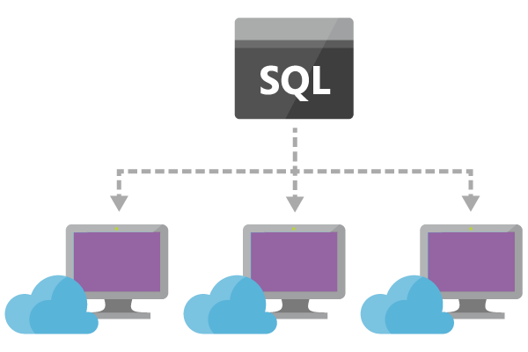
Lowering the bar for developer skills
Data Manipulation
SELECT, FROM, WHERE GROUP
BY, HAVING, CASE WHEN THEN
ELSE, INNER/LEFT OUTER
JOIN, UNION, CROSS/OUTER
APPLY, CAST, INTO, ORDER
BY ASC, DSC
String Functions
Len, Concat, CharIndex
Substring, Lower
Upper, PatIndex
Scaling Extensions
WITH, PARTITION BY
OVER
Date and Time Functions
DateName, DatePart, Day
Month, Year, DateDiff
DateTimeFromParts, DateAdd
Aggregate Functions
SUM, COUNT, AVG, MIN,
MAX, STDEV, STDEVP, VAR
VARP, TopOne
Temporal Functions
Lag, IsFirst,Last
CollectTop
Geospatial Functions
CreatePoint
CreatePolygon
CreateLineString
ST_DISTANCE
ST_INTERSECTS
ST_OVERLAPS
ST_WITHIN
Windowing Extensions
TumblingWindow
HoppingWindow
SlidingWindow
Mathematical Functions
ABS, CEILING, EXP, FLOOR
POWER, SIGN, SQUARE, SQRT
Notes:
The main thing I really want to take away is – when a customer comes to you and says I have real time needs, I want you to think about developer productivity – driven a lot by query language and the promises we have put on top of it. We provide a wide array of functions for analytics on streaming data – all the way from simple data manipulation functions, data and time functions, temporal functions, mathematical, string, scaling and many more. We also have in private preview UDF for ML scoring and Geospatial functions.

Slide 19
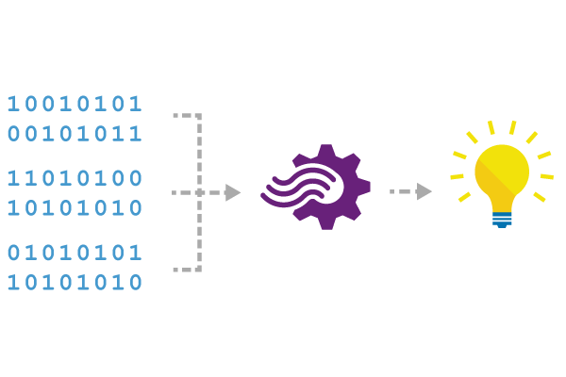
Reference Data
Seamless correlation of event streams with reference data
Static or slowly-changing data stored in blobs
Scanned for changes on a settable cadence
JOIN (INNER or LEFT OUTER) between streams and reference data sources
Reference data appears like another input in the query
SELECT myRefData.Name, myStream.Value
FROM myStream
JOIN myRefData
ON myStream.myKey = myRefData.myKey
Notes:
Next thing is the concept of reference data. This is very important because people want to shrink payload down because you are transporting data over network, GPRS etc.. they only send data that is very relevant. Payload might only look like sensor A, temp x. But, you need to know where this sensor maps to – in other words, where this located, which manufacturer did we get it from etc – in case it fails etc., So this is called reference data. This is data at rest. In ASA we let you add reference data. You can treat reference data as another stream to further augment your streaming data. Right now we only support reference data in Blobs. Can refresh these blobs @ 5 min frequency. Working actively on adding SQL. All I need to – instead of 2 streaming inputs – 1 ref data, 1 streams, Use same joins on reference data, AND augment the data before storing it. By the way, this is one of the more used features. You can refresh the blob too.

Slide 20
Seamless integration for rapid solution development
Ingress
Event Hub
IoT Hub
Blob storage
Reference / Augmentation
Azure Machine Learning
Blob storage
Egress
Live Dashboards: PowerBI
Driving workflows: Event Hubs, Service Bus
Archiving and post analysis: Blob Storage, Document DB, Data Lake, SQL Server, Table Storage
Notes:
When we spoke to the customers as we were designing and definiting the solution, in almost every case stream analytics was a part of a larger solution that customer was trying to deploy. Whether it is real time Dashboarding for monitoring purposes or whether it was real time monitoring of IT infrastructure equipment. This meant that we needed to be thoughtful about providing out of the box integration with a whole plethora of services that could help build a solution in a relatively quick fashion.
On the ingress side, with a few clicks you can connect to Event Hub, IOT Hub or Blog storage.
I can enrich the streaming data with reference data in in blob store.
I can call ML for event scoring in real time.
I can egress data to live Dashboarding to PowerBI, OR, could also push data back to EH from where dashboards and reports can pick it up.
We have customer who is pushing O/P of stream analytics processing into EH and then have azure website hosted solution into their own custom dashboard
I can drive workflows by pushing our events to service bus. For example, we have a customer opening servicenow tickets – they detect anomaly, push result into SB, and I have a worker role that is calling servicenow API to create tickets. I can do archival for post analysis. Don’t just think about real time alerts. You can also use it to aggregate data, filter data before I store in things like blob storage, ADL, Document DB, SQL and then run USQL ADLA analytics, HDInsights or I can call ML models for things like predictive maintenance.

Slide 21
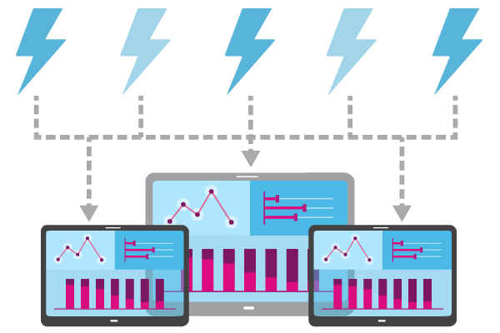
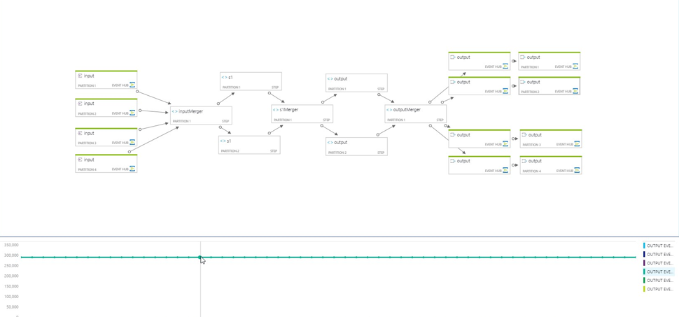
Built in monitoring
View system performance easily
Built in monitoring and debugging tools
Notes:
We also provide a wide array of monitoring and debugging tools to help developer build and troubleshoot Stream analytics queries visually and intuitively.

Slide 22









Real-time Geospatial Analytics Scenarios
 | Phone Tracking Across Cell Sites
 | Connected Car / Trucks - Remote Management & Diagnostics
 | Asset Tracking
 | Fleet Management
 | Facilities Management
 | Personnel Tracking & Crowd Control
 | Ride Sharing
 | Geofencing
 | Racecar Telemetry
 | Connected Manufacturing
and many more…
Notes:
With Stream Analytics, it will become very easy for customers to build solutions for scenarios such as connected cars, fleet management, and mobile asset tracking with tremendous ease using Azure Stream Analytics. Developers can now leverage powerful built-in geospatial functions in their stream-processing logic to define geographical areas, and evaluate incoming geospatial data for containment, proximity, overlap, and generate alerts or easily kick-off necessary workflows etc. These geospatial capabilities are in alignment with the GeoJSON specification.

Slide 23
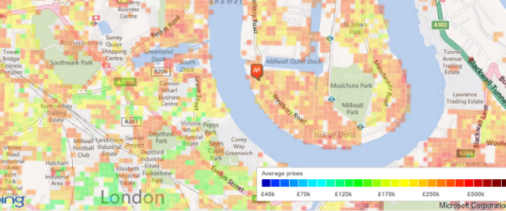
Geospatial Examples
Generate an event when gas is less than 50 km from the car
SELECT Cars.Location, Station.Location
FROM Cars c
JOIN Station s ON ST_DISTANCE(c.Location, s.Location) < 50 * 1000
Generate an event when fuel level is lower than 50%, a gas station is in promotion and course of car is pointing to gas station
SELECT Cars.gas, Cars.Location, Cars.Course, Station.Location, Station.Promotion
FROM Cars c
JOIN Station s ON Cars.gas < 0.5 AND Station.Promotion AND ST_OVERLAPS(c.Location, c.course)
Generate an event when a storm is heading my way
SELECT Cars.Location, Storm.Course
FROM Cars c
JOIN Storm s ON ST_OVERLAPS(c.Location, s.Course)
Generate an event when a store is within a possible flooding zone
SELECT Store.Polygon, Flooding.Polygon
FROM Cars c
JOIN Flooding f ON ST_OVERLAPS(s.Polygon, f.Polygon)
Combination of clustering and heat maps. Clusters are represented using color coded geometric shapes that fit together evenly
Notes:
Talk about some very intuitive examples that can be automated for real time scenarios. These are just a few representative ones.

Slide 24
Custom code w/ JavaScript
Custom Code is Supported Using JavaScript functions call-outs
Stateless functions
Implementers do not need to concern themselves with resilience, or resumption
Scenarios
ASA supports declarative representation of the logically difficult parts of the streaming computations
Custom-code extensibility is meant for logically simple but technically difficult logic:
String parsing and manipulation [e.g. Regexp_Replace() and Regexp_Extract()]
Array operations (e.g. sorting, joining, find, fill)
Regular Expressions
Mathematics operations
Date operations
Notes:
With Azure Stream Analytics, customers can now combine the power of JavaScript with the simplicity and pervasiveness of SQL. Historically, Azure Stream Analytics let developers express their real-time query logic using a very simple SQL like language. That said, customers have also been asking us to support more expressive custom code to implement advanced scenarios. Today, in our journey to offer richer custom code support, we are pleased to announce the support for User defined functions using JavaScript in Azure Stream Analytics. With this new feature, customers can now write their custom code in JavaScript, and easily invoke it as part of their real-time stream processing query.

Slide 25
JavaScript UDF Example
Local definition file for the JavaScript UDF:
{
"properties": {
"type": "Scalar", //Function type. Scalar is the only supported value
"properties": {
"inputs": [ // Function input parameter(s).
{
"dataType": "any", // Input data type
}
],
"output": { // Output
"dataType": "any" // Output data type
},
"binding": {
"type": "Microsoft.StreamAnalytics/JavascriptUdf",
"properties": { // Function definition
"script": "function hex2Int(hexValue) {return parseInt(hexValue, 16);}",
}
}
}
}
}
SELECT
time,
udf.hex2Int(offset) AS IntOffset
INTO Output
FROM InputStream

Slide 26

ML Function callouts
In Public Preview!
Azure ML can publish web endpoints for operationalized models
Azure Stream Analytics can bind custom function names to such web endpoints
SELECT text, sentiment(text) AS score
FROM myStream
Notes:
So, far everything is based on SQL language. There might be things that might be beyond it. Example of this are machine learning models. I might need to score events in real time to get sentiment analytics. Here is a simple scenario. As you can see here, I am making a call to a sentiment function – a ML function I have defined to score my events in real time.

Slide 27
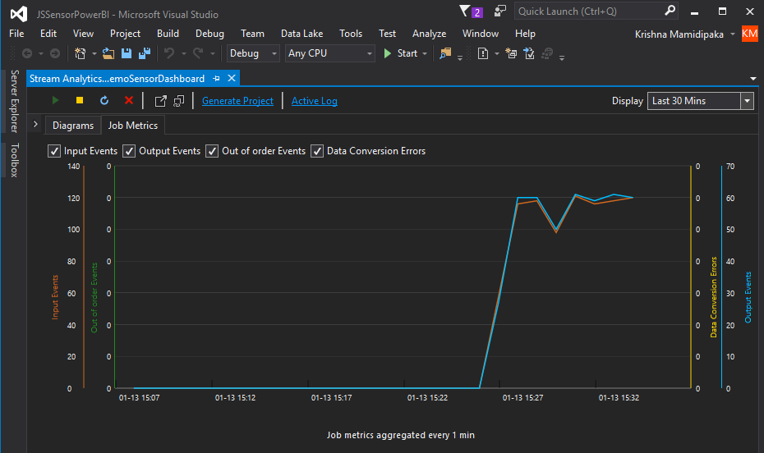
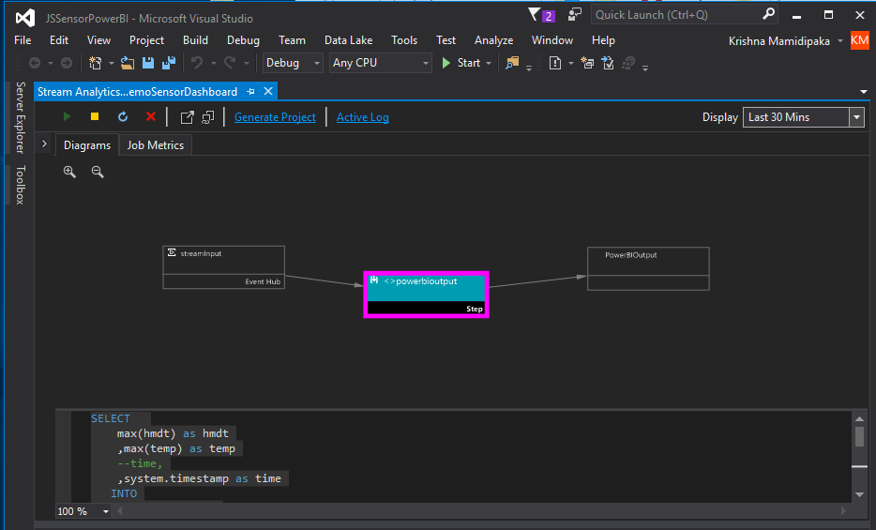
Developer productivity w/ Visual Studio
Create, Manage and Debug ASA jobs in Visual studio
Local testing on client machines for offline query build/test
Source control integration
Supports Intellisense, Syntax highlighting, Error markers
Notes:
To help maximize end-to-end developer productivity across authoring, testing and debugging Stream Analytics jobs, we are rolling out a public preview of Azure Stream Analytics (ASA) tools for Visual Studio. Local testing on client machines to enable true offline query building and testing experience will be one of the key capabilities that will be available. Additionally, features such as IntelliSense (code-completion), Syntax Highlighting, Error Markers and Source control integrations are designed to offer best in class developer experiences.

Slide 28
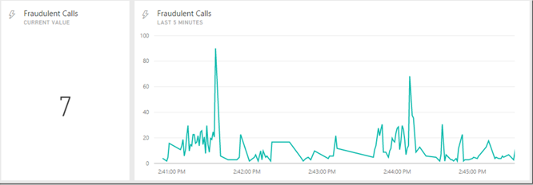
Low latency Power BI Dashboarding
Azure Stream Analytics jobs will be able to write output to the *New* Power BI streaming datasets
Value for customers
Make dashboards much more visual with streaming tiles
Show the latest value from the Stream Analytics output
Show values over a set time window
Lower latency between when the data is pushed to Power BI and when the visuals update
Notes:
In our quest to continually test the boundaries of performance and latencies to serve our customer needs better, we’ve worked closely with our Power BI engineering team to improve dashboarding experiences for solutions built using Azure Stream Analytics. Azure Stream Analytics jobs can now output to the ‘new’ Power BI streaming datasets. This will enable rich visual and dynamic dashboards with a lot lower latency than what was possible until now.

Slide 29
Scenario: Real time analytics on Twitter data
Notes:
Let us dig a little deeper into Azure Stream Analytics key programming concepts with a twitter data analytics example.

Slide 30
Scenario – Twitter Analytics
“A news media website wants to increase site traffic by covering trending topics on social media.”
To determine which topics are immediately relevant to customers, they need real-time analytics about the tweet volume and sentiment for each topic.
Twitter payload
ID | CreatedAt | UserName | TimeZone | Text | Language | Topic
1 | 2015-04-30T20:45:30 | Joshua X | Eastern Time (US & Canada) | Oh, joy! More forced @Xbox Live updates | en | XBox
2 | 2015-04-30T20:45:31 | Cristabel Y | London | RT @verge: Streaming Xbox One games .. | en | XBox
 | …
Notes:
Let’s say, we have a news media website that wants to sell paid advertisements by covering trending topics on twitter.
Let’s assume the Payload from twitter is fairly simple – ID, Created At, User name, time zone, Text, language and topic. Say, all this info is flowing from twitter or intermediary service into EH
First thing – filter the data.

Slide 31
Count
SELECT count(*), Topic FROM InputStream
GROUP BY Topic, TumblingWindow(second, 5)
Notes:
Take another example, let’s say I want to project what the trending topics on Twitter are in the last 5 seconds.. Note that in this case, the data is time bound. All, I need to do is write this 2 lines of logic. That’s it.
Select count (*), from Tweets group by Topic based on a 5 second tumbling temporal window. I will come to what a tumbling window is in a few minutes. Imagine writing this query in any other tool.

Slide 32
Filters
Show me the user name and time zone of tweets on the topic XBox
"Haroon”, “Eastern Time (US & Canada)”
“XBox”,(…)
“Zach Dotseth“, “London”, “Football”,(…)
"XO",”London”,
“XBox“, (…)
time
"Haroon”, “Eastern Time (US & Canada)”
"XO", “London”
SELECT UserName, TimeZone
FROM InputStream
WHERE Topic = 'XBox'
Notes:
Next, let’s say I wanted to get a stream of tweets with XBOX in them, all I need to do is write a simple SQL query that looks like, select UserName and Timezone where topic = xbox. So, why is this important? This is where I want to understand something about stream processing solution. Stream processing solution takes in an input stream and gives you an output stream. The logic is in between; this logic says – my output stream should only contain events that say xbox. As simple as that.

Slide 33
Projections
Tell me the time, user name and if the language is English or not
"2014-11-04T23:55:10", “Zach Dotseth“, “en”, (…)
“2014-11-04T23:55:11", "Haroon”, “pk", (…)
"2014-11-04T23:55:12", "XO", “en“, (…)
SELECT CreatedAt, UserName,
Language=
CASE Language
WHEN 'en' THEN 'English'
ELSE 'Non English'
END
FROM InputStream
time
"2014-11-04T23:55:10",
“Zach Dotseth“, “English”
“2014-11-04T23:55:11", "Haroon“ , “Non English”
"2014-11-04T23:55:12", "XO”, “English”
Notes:
Next thing – very simple. Let’s say I want to highlight tweets that are English versus not… Select created at and username, where language when it is EN it is called English, else non English. What did I just do - I augmented a stream in real time in order to do this.

Slide 34
Windowing Concepts
Windows can be – Hopping, Sliding or Tumbling
Windows are fixed length
Must be used in a GROUP BY clause
Window 1
Window 2
Window 3
1
5
4
6
2
8
6
4
Time
t1
t2
t3
t4
t5
t6
Aggregate
Function (Sum)
Output Events
18
14
Notes:
Next thing I want to talk about is the windowing concepts. This is also super key and very fundamental for you to start writing your stream processing jobs. We support 3 types of windows in stream processing – Tumbling, Hopping, and Sliding windows. All windows are of fixed length and an output will get generated at the end of every window.

Slide 35
Tumbling Windows
Every 10 seconds give me the
count of tweets over the last
10 seconds
A 10-second Tumbling Window
1
5
4
6
2
8
6
5
3
6
1
0
5
10
15
20
25
30
Time
(secs)
1
5
4
6
2
8
6
5
3
6
1
SELECT TimeZone, COUNT(*) AS Count
FROM InputStream TIMESTAMP BY CreatedAt
GROUP BY TimeZone, TumblingWindow(second,10)
Notes:
Tumbling window: Let’s say I want to know, the count of tweets about a topic in a 10 second window and want to know the result every 10 seconds from a stream of data. Simple case of count(*) operation every 10 seconds. Frequency of output is same as the window size.

Slide 36
Hopping Windows
A 10-second Hopping Window with a 5-second “Hop”
Every 5 seconds give me the count of tweets over the last 10 seconds
1
5
4
6
2
8
7
5
3
6
1
0
5
10
15
20
25
30
Time
(secs)
1
5
4
6
2
4
6
2
8
6
8
6
5
3
SELECT Topic, COUNT(*) AS TotalTweets
FROM TwitterStream TIMESTAMP BY CreatedAt
GROUP BY Topic, HoppingWindow(second, 10 , 5)
5
3
6
1
Notes:
Hopping Window: Let me augment this concept a little bit. Frequency of output different from the window size. Let’s say I still want the count of tweets for the past 10 seconds, but I want a result every 5 seconds. Some amount of duplication of results. The window size for aggregation of results hasn’t changed, but I am getting the results at a faster frequency. This is very important when I do comparisons. Remember when I said, I want in certain cases to compare results from a large window with a small window – something like I want to compare the avg temperature every 5 minutes with the average temperature from the same set of sensors over the past 1 hour period – we use something like a hopping window.

Slide 37
Sliding Windows
Give me the count of tweets for all topics which are tweeted more than 10 times in the last 10 seconds
A 10-second Sliding Window
Entry
1
5
0
5
10
15
20
25
Time
(secs)
Exit
1
5
1
1
5
5
SELECT Topic, COUNT(*) FROM TwitterStream
TIMESTAMP BY CreatedAt
GROUP BY Topic, SlidingWindow(second, 10)
HAVING COUNT(*) > 10
Notes:
Sliding Window: Next thing is the sliding window. Very interesting. Most customers we know use Sliding window in pattern detection. So, when an event happens, what happened before the event and after. So for this – sliding window is a window which gives an output when an event enters or leaves the system. In this case, you will get an output as soon as 1, 5 or 9 came in – you can see the aggregates here. But, when 8 came in nothing happened in the previous 10 seconds. So, you see only 1 result.

Slide 38
Joins
“List all users and the topics on which they switched their sentiment within a minute“
Twitter Stream:
{“XO”, 4, “Win10”}
{“Dip”, 2, “XBox”}
{“Jo”, 0, “Surface”}
{“Foo”,4, “Bing”}
Twitter Stream:
(same stream,
further down the timeline)
{“XO”, 0, “Win10”}
{“Jo”, 4, “Surface”}
{“Dip”, 0, “Xbox”}
{“Foo”, 0, “Bing”}
time
SELECT TS1.UserName, TS1.Topic
FROM TwitterStream TS1 TIMESTAMP BY CreatedAt
JOIN TwitterStream TS2 TIMESTAMP BY CreatedAt
ON TS1.UserName = TS2.UserName AND TS1.Topic = TS2.Topic AND DateDiff(second, TS1, TS2) BETWEEN 1 AND 60
WHERE TS1.SentimentScore != TS2.SentimentScore
Notes:
Then I talked about joining multiple streams together. One very important thing – and I will reiterate this. I was talking to a customer who is running data centers. An interesting problem they have. There are these fans on top that are trying to cool the datacenter. And the way you measure their effectiveness is through air pressure sensors on the floor that measure how much pressure of air from fans is actually hitting the ground. Unfortunately, these 2 systems don’t talk to one another because for all you know, they might have been purchased from different vendors. The problem is – how do you make different proprietary systems talk to one another for critical command and control operations. This is where Azure Stream Analytics can take both these streams and join them over time.
Let me make this more real and give you the example from the twitter universe. Let’s say the question I am asked is – list all users and topics on which they changed their sentiment within a minute. Seems pretty hard right! Because of the complexity of the logic as well as the volume of information. In Azure Stream Analytics, this can be done with a very simple query – I take the same stream and duplicate it. I want to select from my first stream all users and topics with the created at timestamp (in twitter) – and join it with my second stream where the user names and topics are the same within that 1 minute window where the sentiment has changed. That’s it.
By the way, word of caution, think carefully about how you are using join statements. If you do not think hard about the window size, long windows will almost always require arbitrarily high levels of memory. Implications on performance and costs. I can do things like left outer join - because left outer joins are widely used in SQL to detect absence of event. Left outer join where something is NULL and so on.

Slide 39
Detecting absence of events
Show me if a topic is not tweeted for 10 seconds since it was last tweeted.
Twitter Stream:
{“XO”, 4, “Win10”}
{“Dip”, 4, “Xbox”}
{“WAA”, 2, “Microsoft”}
{“AB”, 0, “Bing}
Twitter Stream:
{“Foo”, 0, “Win10”}
{“Tim”, 2, “Microsoft”}
{“AB”, 0, “Bing”}
time
SELECT TS1.CreatedAt, TS1.Topic
FROM TwitterStream TS1 TIMESTAMP BY CreatedAt
LEFT OUTER JOIN TwitterStream TS2 TIMESTAMP BY CreatedAt
ON TS1.Topic = TS2.Topic AND DATEDIFF(second, TS1, TS2) BETWEEN 1 AND 10
WHERE TS2.Topic IS NULL

Slide 40

Partitions
Partitioning allows for parallel execution over scaled-out resources
SELECT Count(*) AS Count, Topic
FROM TwitterStream PARTITION BY PartitionId
GROUP BY TumblingWindow(minute, 3), Topic, PartitionId
Event Hub
Stream Analytics
PartitionId = 1
Query
Result 1
PartitionId = 2
Query
Result 2
PartitionId = 3
Query
Result 3
PartitionId = 1
PartitionId = 2
PartitionId = 3
Notes:
The next thing I can do is scaling and partitioning. This is very essential because I talked about memory footprints and limitations. We have the concept of streaming units. Currently, anytime you cross 12 SUs, you need to actually partition your payload. At the same time, people might want to partition payload for other reasons and scenarios.
Lets say, on NFL Sunday – you know there are 32 or so teams playing. I want to monitor twitter feeds for all these 32 teams individually. I want to see what is happening for each team. I could use Group By keyword but twitter is going to send a lot of information on Sunday when the game is going on. So, I need to start partitioning my query. Azure Stream Analytics is a truly distributed stream processing solution. And this is very important – distribution of stream processing solution across various nodes by the use of ‘partition by’ keyword.
How do I do it – just simply use partition by keyword in your query. Can do it in multiple ways –
1 - strongly recommended ask customers to do this – send data to event hub already partitioned to the different partition IDs. And then partition by partition ID just picks up from partitions within Event Hub.
2- You could also use use ‘Partition by Keyword’ – But this will add some latency to your system. Recommend that you don’t do it.

Slide 41
Events and Time
Every event that flows through the system has a timestamp
User can pick it from the payload
SELECT * FROM TwitterStream TIMESTAMP BY CreatedAt
Or the system can assign timestamps automatically based on the event arrival time
SELECT * FROM TwitterStream
Notes:
The concept of time is really important when you think of Stream analytics or stream processing. Two types are very important:
#1 is the time stamp associated with an event when it arrives into ingress source such as EH
#2 the timestamp when the event was actually generated at the device or sensor level.
With Azure Stream Analytics, we give you flexibility to choose based on which time you want to do processing on. Azure Stream Analytics uses this keyword called ‘Timestamp By’. If your payload – if you remember – twitter payload ‘created at’, if I want to, I can use this created at. If I didn’t use that, all processing will be done based on the timestamp of the event when the event came to the event hub.
It all depends on your scenario.

Slide 42
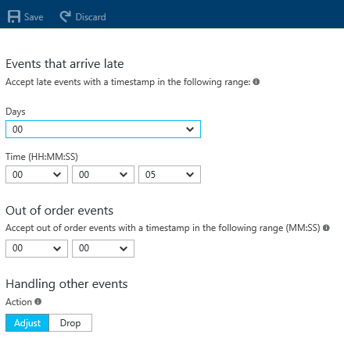
Event processing semantics
At least once delivery guarantees
Out of order policy
Late arrival policy
Notes:
Let me talk about Event processing semantics. These concepts that we support through simple configuration settings are really helpful to differentiate ourselves.
At least once delivery and we promise that we will never lose any events. This actually built into the system. You don’t have to do anything.
Out of order policy is another interesting thing, where I can tell the system to wait for a certain period of time to ensure all the data comes into the EH or IOT hub before I start processing. Maybe some events are coming in from TCP IP connections, some via Bluetooth and so on. This is important where sequence of events is key for your analysis. Basically on our configuration settings, I can say how long I want to wait for the events to happen. And, if the events are after this long 5 minute window because it is irrelevant for me. You can say – things like drop the event or adjust the timestamp. These are things that are built into the system.
The other thing is the concept of late arrival policy – shining example of how we react to customer feedback. Honeywell great customer of ours – there is a customer case study as well. What if I am monitoring multiple buildings and we now have to worry about gateways induced latencies. To handle this we built something called late arrival policy – which you as a person understands gateways and their latencies – can say something like don’t start my processing until you wait for x minutes - which is just enough for all my gateways to catch up. Again, this is as simple as a configuration. And theoretically I can actually wait for days – this is the flexibility of highly sophisticated temporal concepts. You can got to a customer and say – “hey, do you have problem with gateways with different latencies or do you have sensors with different latencies? ASA can handle all such scenarios without you needing to write any code”

Slide 43
Demo
Notes:
BUILT IN MONITORING
TWITTER SENTIMENT ANALYTICS

Slide 44
Roadmap

Slide 45
Azure Stream Analytics: Ready to use solution gallery
Predictive Maintenance for Aerospace
IT Anomaly Insights
Stream Analysis with Azure ML
Vehicle Telemetry Analysis
Real time fraud detection
And many more coming!
https://gallery.cortanaintelligence.com/

Slide 46
Coming soon!
IoT Edge Analytics
Customer code through user defined functions (Python, R, C#)
Time series Data exploration
Azure Stack
SQL DB Reference data support
Notes:
Edge
Managed devices need to be connected to IoT hub – could be Gateway or sensor
1 click deployment of runtime on device
Devices that can support Node JS based runtime
Supporting a wide array of operations on the devices – batching, aggregation and filtering
Run Stream Analytics on managed edge Gateways – managed by IoT hub
Same SQL language across cloud and edge devices
Automated deployment of logic on edge devices through Azure IoT integration
Geospatial
Powerful functions for:
Intersection, proximity & overlap detection
Native support for custom polygons
Command & control consoles using BingMaps and PowerBI
RDX
RDX delivers real-time data exploration experiences on a time-series data at scale to fulfill multiple scenarios:
Visualize millions of events interactively
Learn schema and understand data quickly
Discover interesting trends & patterns

Slide 47
SPARK Streaming on HDInsights

Slide 48
Why deploy Spark Streaming on HD Insights
Fully
managed
Rapid
setup
Latest
bits
99.9%
SLA
Compliant
PCI, ISO 27018, SOC
HIPAA, EU-MC etc
Out of the Box
Integrations with
Azure HDInsights
R-Server
Power BI, Tableau, SAP Lumira and Qlikview
Event Hub
iPython Notebook
IntelliJ IDEA
Kafka
Notes:
With Spark for HDInsight, there’s no time-consuming installation or set up. Azure does it for you. You’ll be up and running in minutes and can deploy Spark without buying new hardware or facing other up-front costs.
To make sure Spark will run at scale, we integrated Spark with Azure Data Lake Store. This integration is uniquely available from Microsoft allowing Spark to store and process data that scales to any size without forcing changes to your application as data grows
Spark for Azure HDInsight can be leveraged as an engine to run R Server, which has the largest parallel analytics and machine learning library built to work with the open source R language
To run Spark at the highest scale, Microsoft provides the industry’s highest availability SLA guarantee at 99.9% to ensure your business continuity and protection against catastrophic events

Slide 49


Helping customers shop brilliantly
“To determine prices in real time, we have to monitor 10s of millions of products across thousands of merchants in real time. By leveraging Azure services we built a full fledged ecommerce marketplace in under 12 months. This would not have been possible without Microsoft Azure.”
- Mike Hanrahan, Co-Founder and CTO
Notes:
Marc Lore is perhaps best known as the creator of the popular e-commerce site Diapers.com, which was eventually sold to Amazon. Now, the entrepreneur and his team are competing head-on with the e-retailing giant through an innovative online marketplace called Jet.com. To get up and running quickly, Jet built its entire e-commerce platform, including development and delivery infrastructure, on Microsoft Azure, using both .NET and open-source technologies.
At Jet.com revoluytionizng ecommerce. They are able to do – because they leverage cloud.
At Jet.com we focus on transforming e-commerce by innovating on price. In real time, we price products based on what’s in people’s shopping baskets in real time. To do so, we have to monitor 10s of millions of products across thousands of prices across thousands of merchants in real time. By leveraging Azure services we built a full fledged ecommerce marketplace in under 12 months. This would not have been possible without Microsoft Azure.

Slide 50
One platform: Multiple options!
Positioning guidance for field sellers
Lowest
TCO
Maximum CONTROL
Fully managed – 3 9s of availability
SQL like query language
Machine Learning integrations
Integrations for real time Dashboarding
Custom code extensions
Managed Spark Streaming & Storm
SLA with 3 9s of availability
Integrations with Kafka, ipython notebook R-Server
Full stack control
Azure Stream Analytics
Spark Streaming & Storm on HD Insight (Open Source)
SQL Streaminsight
Notes:
Every developer has a trade-off between speed and control. Imagine it as a spectrum, and I will illustrate how to choose between multiple deployment models
The traditional IaaS based deployment model is to build using VMs and VM extensions. This obviously offers the most control to the developers
Next comes the ability to scale out those apps using VM scale sets and the in-built automation. Still using VMs – but using the underlying platform for auto-scaling
When it comes to microservices and building cloud-native apps with containerizations – we have Service fabric. In fact , service fabric as a PaaS technology powers most of Azure – and I will talk about this in detail later
Finally – for web apps, logic apps, media apps, API apps, and mobile apps – we have Azure app service which is our PaaS service
We have recently announced an even faster, more agile , and easy to use PaaS service called Powerapps targeted at Business users for creating simple mobile apps and business workflows- without requiring any knowledge of a programming language
What that means for you for service providers is that you now have more choices for developer entry points along control-speed continuum . The question is “Where do I start” not “Which do I choose”. As partners who are traditionally focused on IaaS – you can now offer multiple entry points to your customers which gives them different agility, control, flexibility into their development environment.

Slide 51
Backup

Slide 52


Edge Analytics
Run Stream Analytics on managed edge Gateways
Same SQL language across cloud and edge devices
Automated deployment of logic on edge devices through Azure IoT integration
Works for:
Low latency processing at adge Gateway’s
Filtering or aggregating data at Edge
Disconnected scenarios

Slide 53
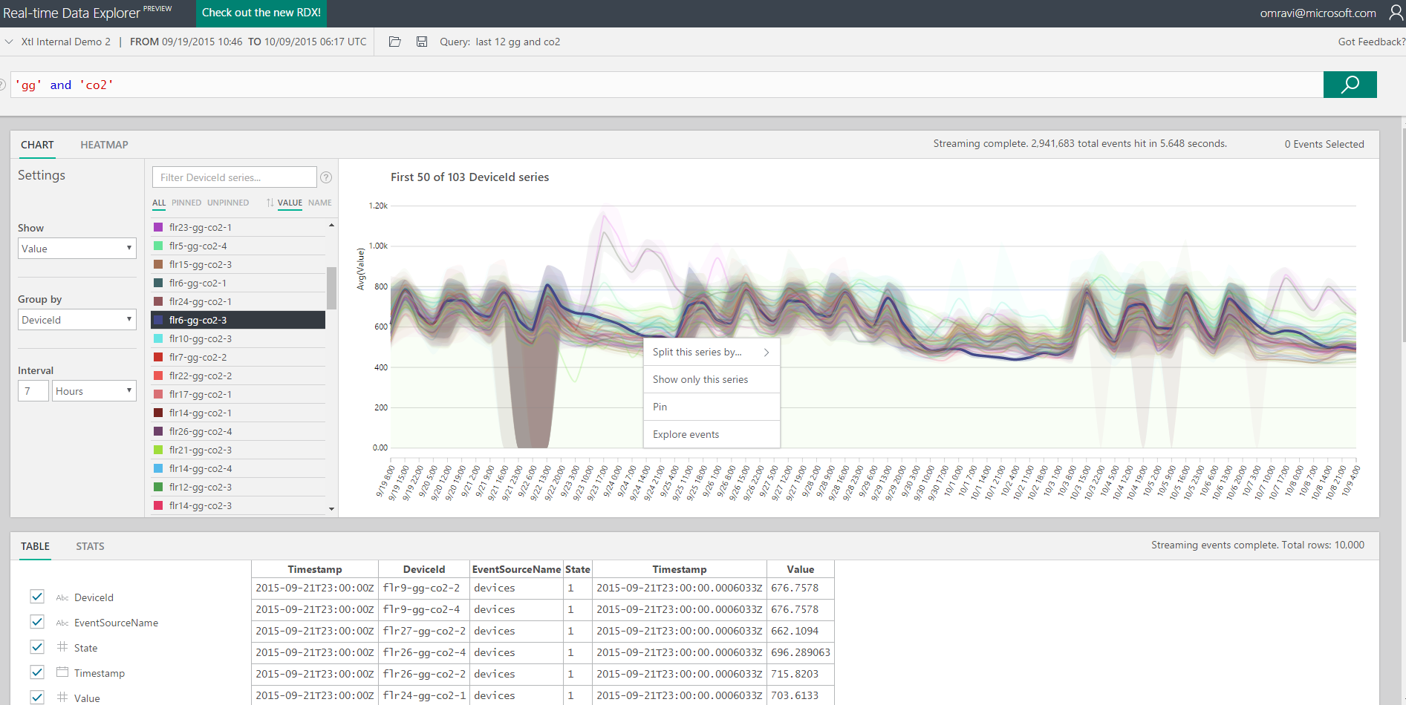
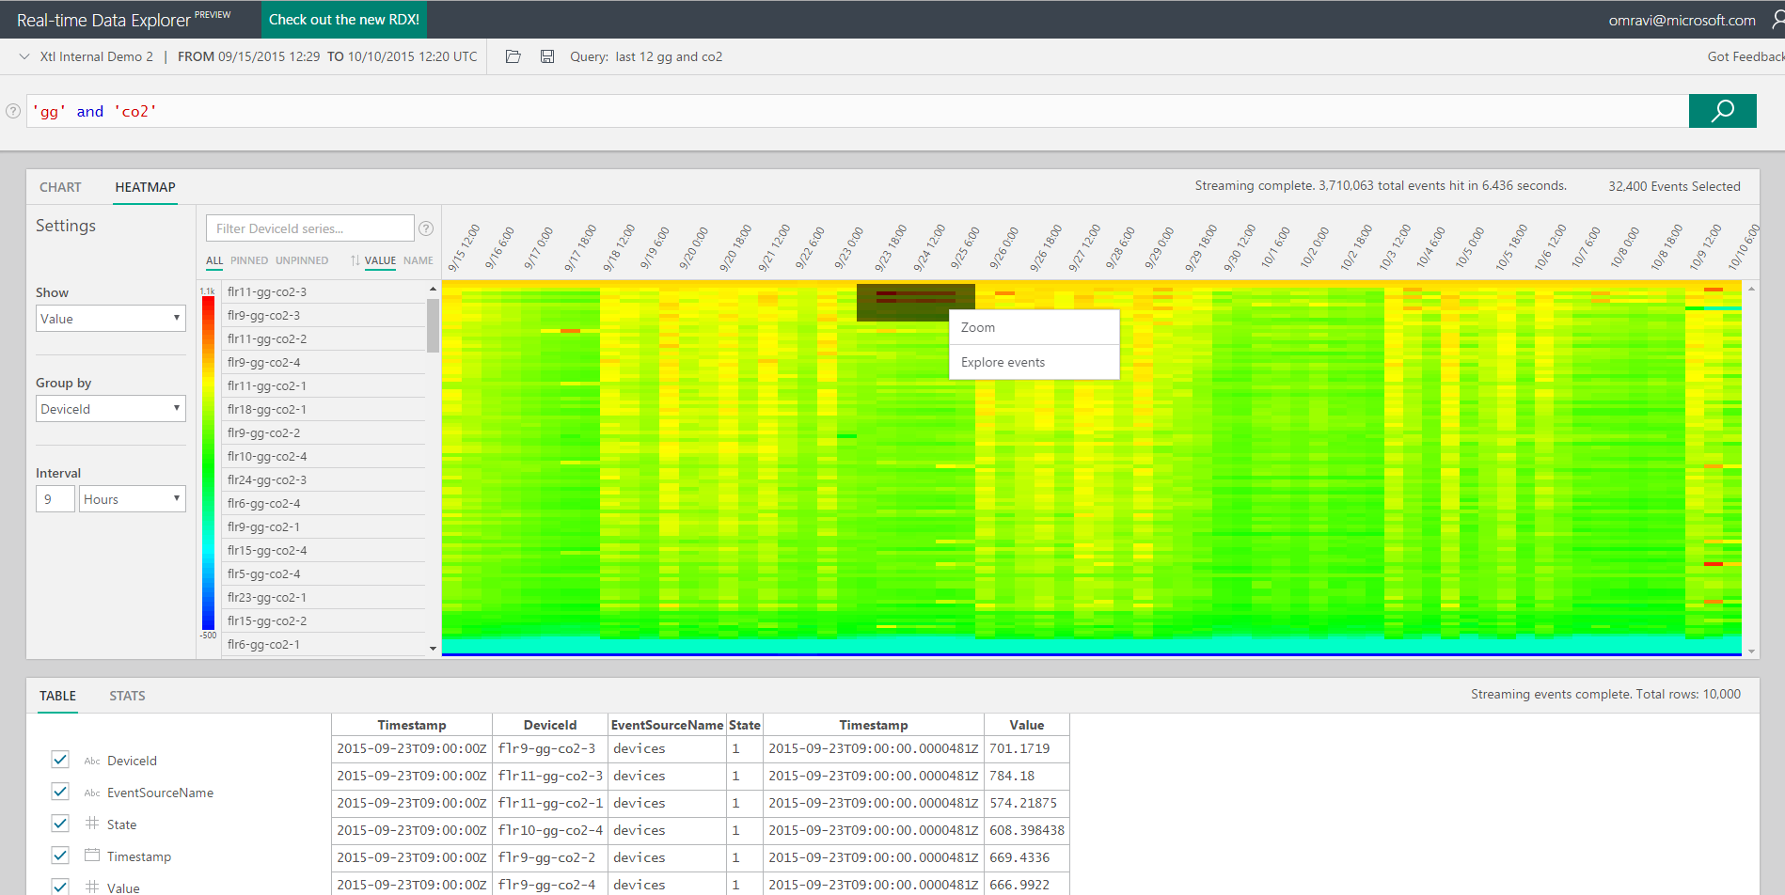
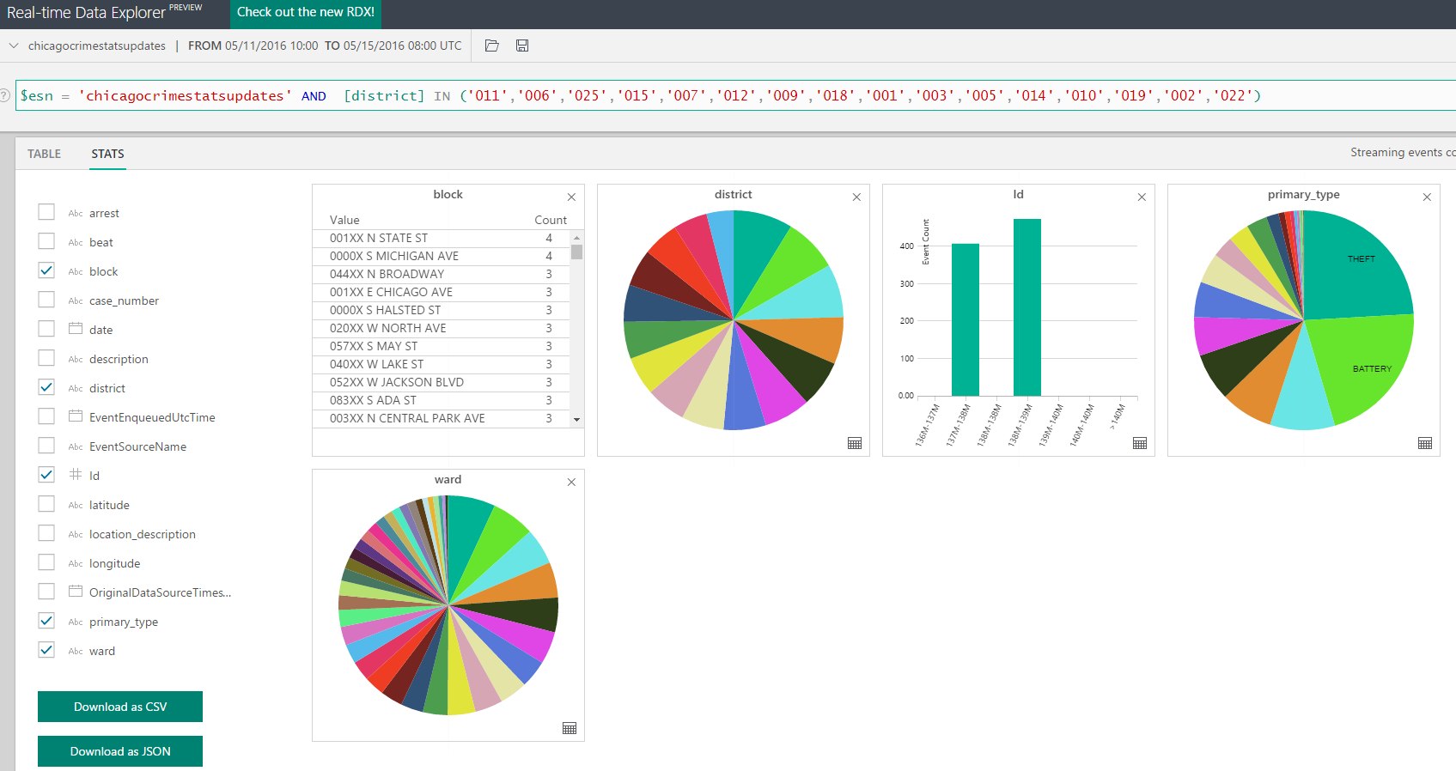
Real-time Data & eXplorer (RDX)
RDX delivers real-time data exploration experiences on a time-series data at scale to fulfill multiple scenarios:
Visualize millions of events interactively
Learn schema and understand data quickly
Discover interesting trends & patterns
Find anomalies in minutes
Expedite root-cause analysis
Join event data with reference meta-data

Slide 54
Temporal Semantics
Windowing functions
Application or ingest timestamp
Manage out of order events
Manage latencies between ingress sources
Manage streams with multiple timelines
Join multiple streams on temporal windows
Join streaming data with data at rest
Adaptive micro-batching
Score with ML functions
Notes:
Why this is possible - ASA is built on Trill which uses CEDR algebra researched in MSR in mid 2000’s, followed by releasing a CEP product with SQL Server called StreamInsight. ASA further builds on Trill for a distributed scale out architecture for cloud based stream processing and CEP.

Slide 55
Programmatic Access with REST APIs
Jobs Management
Start Job
Stop Job
Create Job
Delete Job
List Jobs
Update Job
The full functionality of Azure Stream Analytics is through REST APIs.
Enables programmatic access
Useful for automation through scripting
Embed in other applications/tools
Input and Output
Management
Create Input / Output
Delete Input / Output
List Input / Output
Update Input / Output
Transformations
Management
Create Transformation
Delete Transformation
Get Transformation
Update Transformation

Slide 56
Overview of Spark streaming
Based on Apache Spark framework
Lets users write streaming jobs the same way as the batch jobs
Supports Java, Scala and Python
Key Highlights
of Spark
Exactly once processing
Deployment
mobility
Query language expressiveness
Easily modify
cluster settings
Notes:
Azure Stream Analytics is a fully managed, highly scalable cloud service for real time analytics on streams of data, using a simple SQL like query language.

